Slide 1
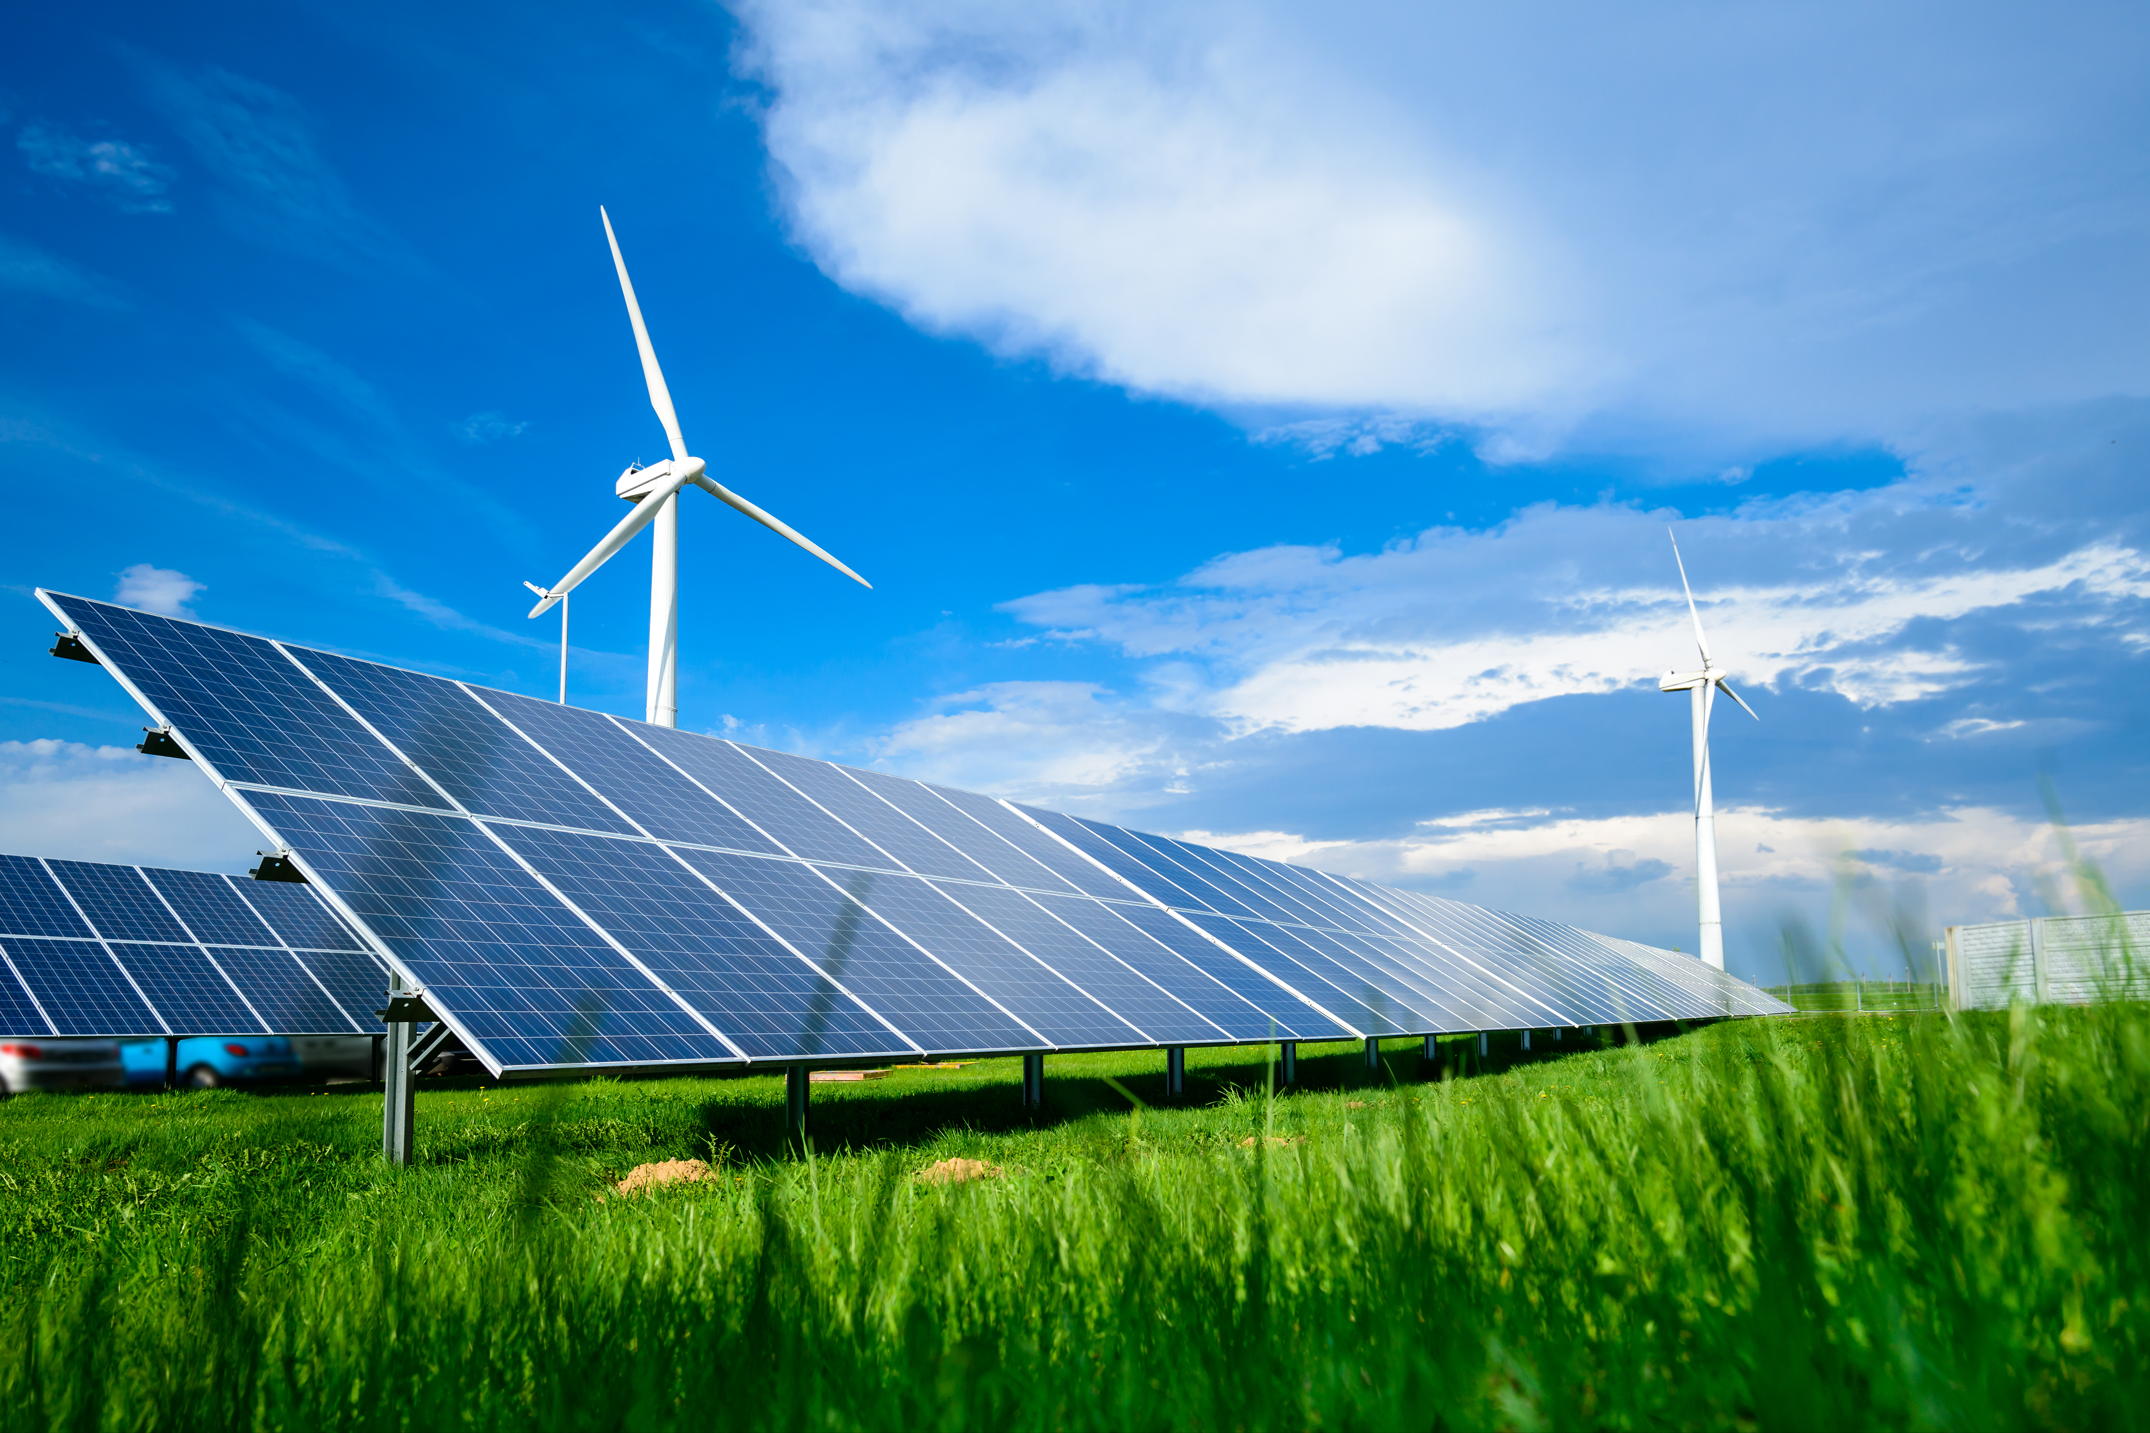
Global Investment in Renewable Energy and Consumption
September, 2020
Group 2 :
Chad Dubiel
Alexander Riner
David Amado Martinez
Corey McCulley
Gina Canales

Slide 2

PROJECT CONTENTS
01
CONTEXT
Paris Climate Agreement
The effects Global Warming of 1.5º C and IPCC
Renewable Energy’s Role in Reducing Greenhouse Gas Emissions
02
ANALYSIS GOALS
Investigate CO2 and non-CO2 GHG emissions
Investigate Investment Data for Largest Economies
Investigate Total Final Energy Consumption and Renewable Energy Consumption by Country Annually
03
RESULT OF ANALYSIS
Emissions
Investments
Energy Consumption
04
CONCLUSIONS, SOURCES, AND REFERENCES

Slide 3

01
CONTEXT
Paris Climate Agreement
196 state parties met in 2015 with the goal of “[h]olding the increase in the global average temperature to well below 2°C above pre-industrial levels and pursuing efforts to limit the temperature increase to 1.5°C above pre-industrial levels”¹
US subsequently announced its intention to withdraw from the Agreement in 2017.
1 Paris Agreement [referring to United Nations (2015), Paris Agreement],United Nations, New York, https://treaties.un.org/doc/Treaties/2016/02/20160215%2006-03%20PM/Ch_XXVII-7-d.pdf.

Slide 4
01
CONTEXT
The Effects of Global Warming and IPCC
The Intergovernmental Panel on Climate Change (IPCC) is the United Nations body for assessing the science related to climate change
The IPCC released a special report in 2018. The report highlights a number of climate change impacts that could be avoided by limiting global warming to 1.5°C compared to 2°C, or more. For example:
By 2100, global sea level rise would be 10 cm lower with global warming of 1.5°C compared with 2°C.²
The likelihood of an Arctic Ocean free of sea ice in summer would be once per century with global warming of 1.5°C, compared with at least once per decade with 2°C.²
Coral reefs would decline by 70-90 percent with global warming of 1.5°C, whereas virtually all (> 99 percent) would be lost with 2°C.²
2 IPCC (2018), Global Warming of 1.5°C. An IPCC Special Report on the impacts of global warming of 1.5°C above pre-industrial levels and related global greenhouse gas emission pathways, in the context of strengthening the global response to the threat of climate change, sustainable development, and efforts to eradicate poverty

Slide 5
01
CONTEXT
The Role of Renewable Energy in Reducing Greenhouse Gas Emissions
“Renewable energy sources, coupled with steadily improving energy efficiency, offer the most practical and readily available solution within the timeframe set by the IPCC.”³
3 IRENA (2019), Transforming the Energy System -- and Holding the Line on Rising Global Temperatures, International Renewable Energy Agency (IRENA), Abu Dhabi.

Slide 6
02
ANALYSIS GOALS
Pillars
3 pillars of our data analysis:
CO2 and non-CO2 GHG emissions
Investment Data for Largest Economies
Investigate Total Final Energy Consumption and Renewable Energy Consumption by Country Annually

Slide 7
02
ANALYSIS GOALS
Research Questions
What nations/economies have the highest percentage use of renewable energy of their total final energy consumption?
Who are the largest producers of carbon emissions? Why?
How do the US, EU (with the UK) and China compare as far as investment in renewable energy?
How does RE investment compare across different world regions?
Is sufficient investment being made to make renewable energy a significant portion of world energy needs?

Slide 8

03
ANALYSIS
INVESTMENTS
EMISSIONS
ENERGY
CONSUMPTION

Slide 9
03
ANALYSIS
Emissions

Slide 10
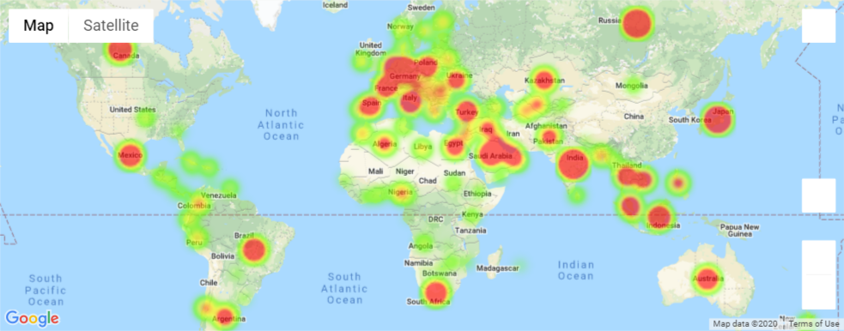
03
ANALYSIS
Emissions
CO2 Emissions Heatmap 2015

Slide 11
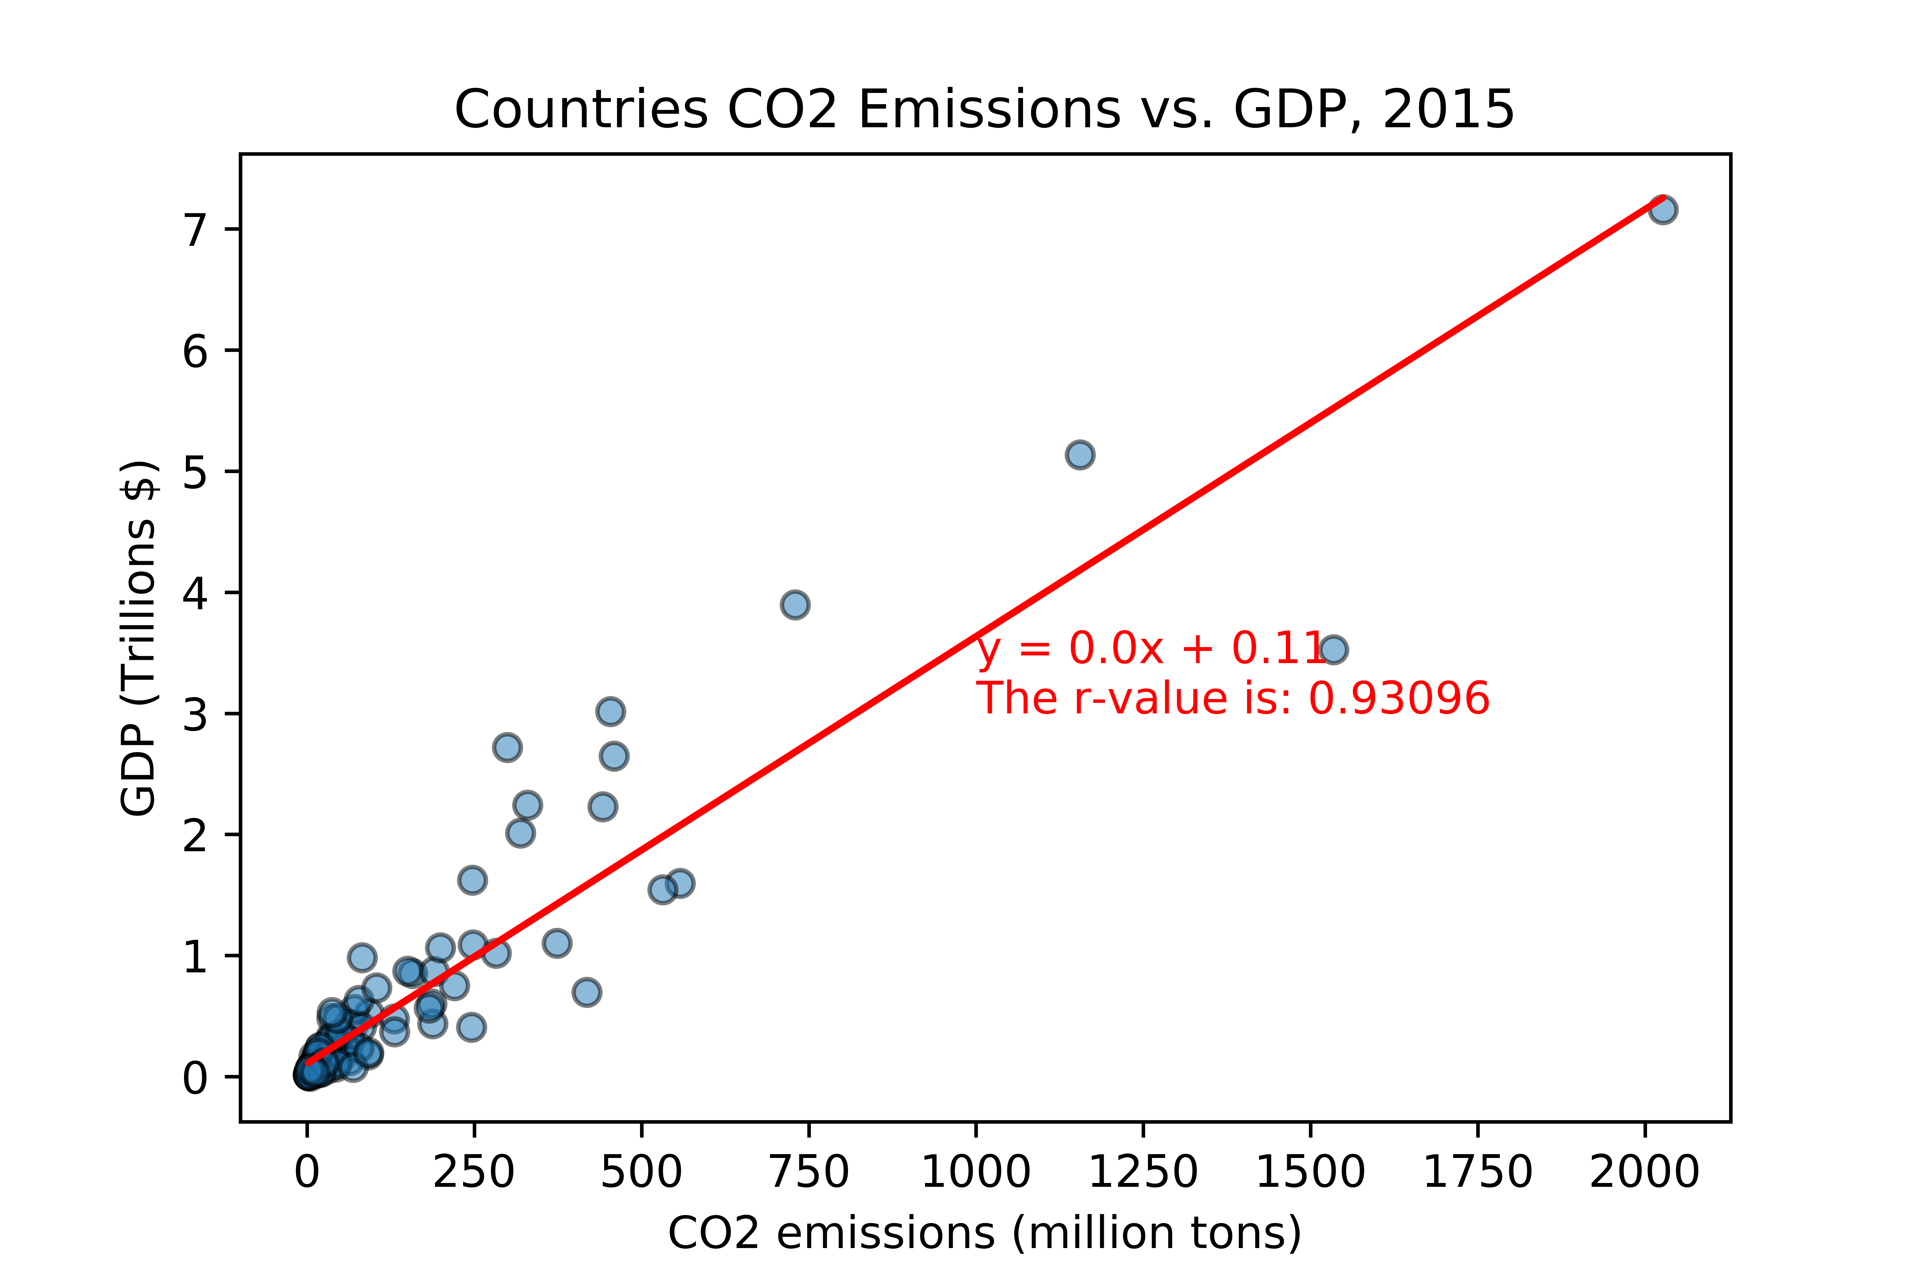
03
ANALYSIS
Emissions
GDP and Emissions Correlation

Slide 12
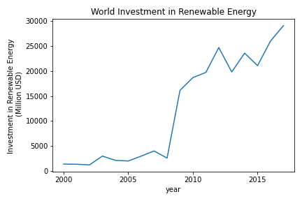
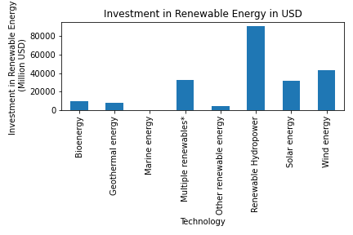
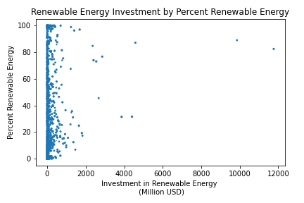
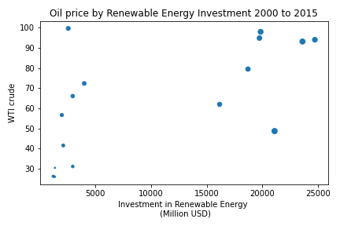
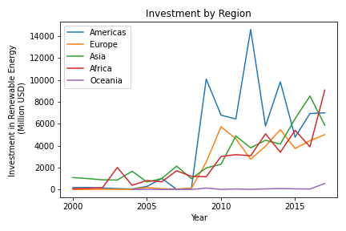
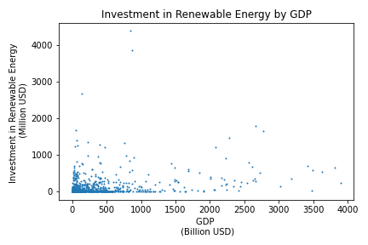
03
ANALYSIS
Investment

Slide 13
03
ANALYSIS
Energy Consumption
What does RE consumption look like between UN member nations?
How have the EU, USA, and China energy consumption grown with their economies over time?
Is there a relation in the RE output and RE output percentage for the EU, USA, and China in relation to their GDP? If so, what does this mean?

Slide 14
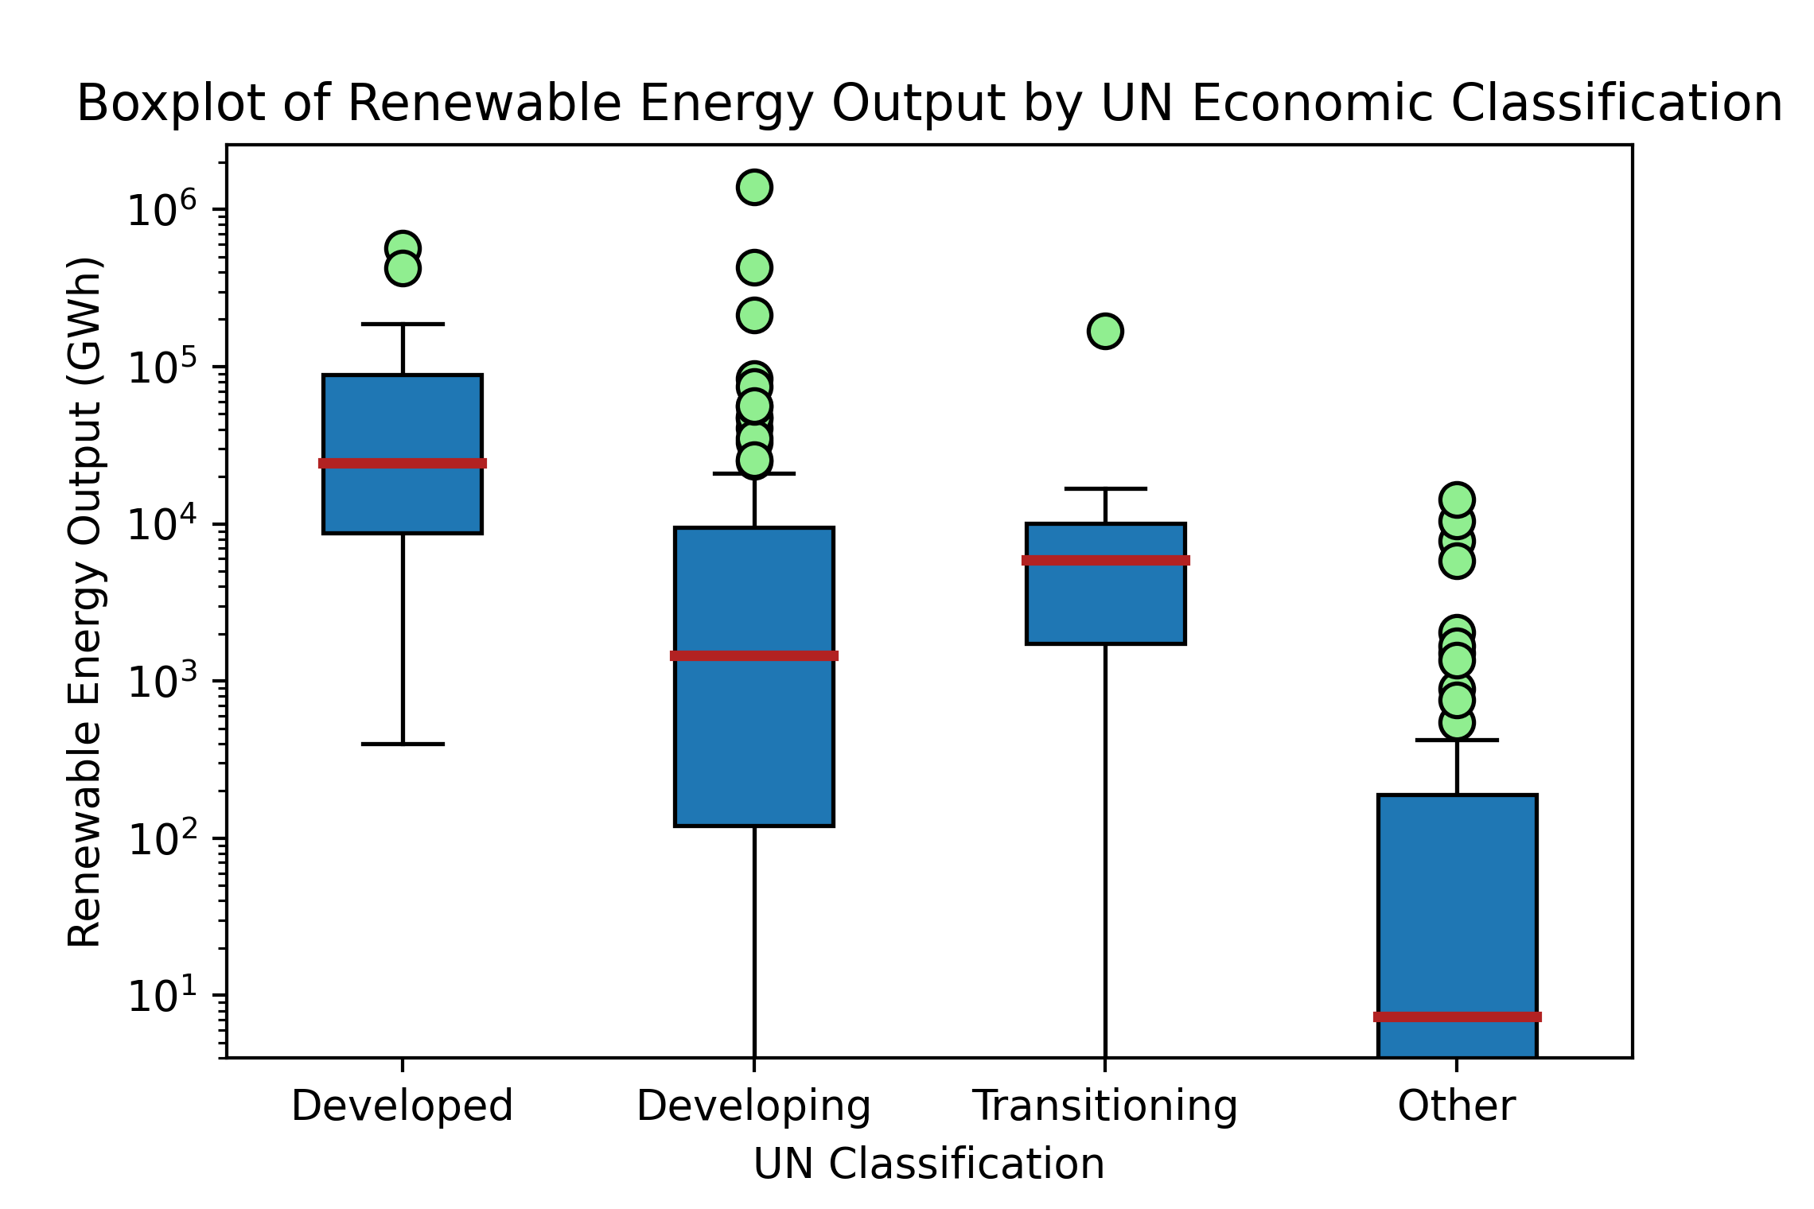
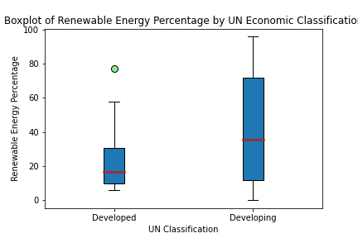
03
ANALYSIS
Energy Consumption
UN Member Energy Consumption 2015
*All classifications passed normality test
*Only 2 classifications passed normality test
*2015 was last year data was publicly available
https://www.iea.org/data-and-statistics?country=WORLD&fuel=Energy%20supply&indicator=Total%20energy%20supply%20(TES)%20by%20source

Slide 15
03
ANALYSIS
Energy Consumption
EU, USA, and China Total Energy Consumption 1990 - 2015
https://www.iea.org/data-and-statistics?country=WORLD&fuel=Energy%20supply&indicator=Total%20energy%20supply%20(TES)%20by%20source
http://data.imf.org/GDP

Slide 16
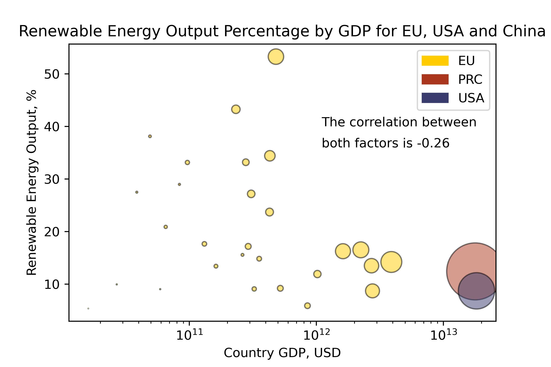
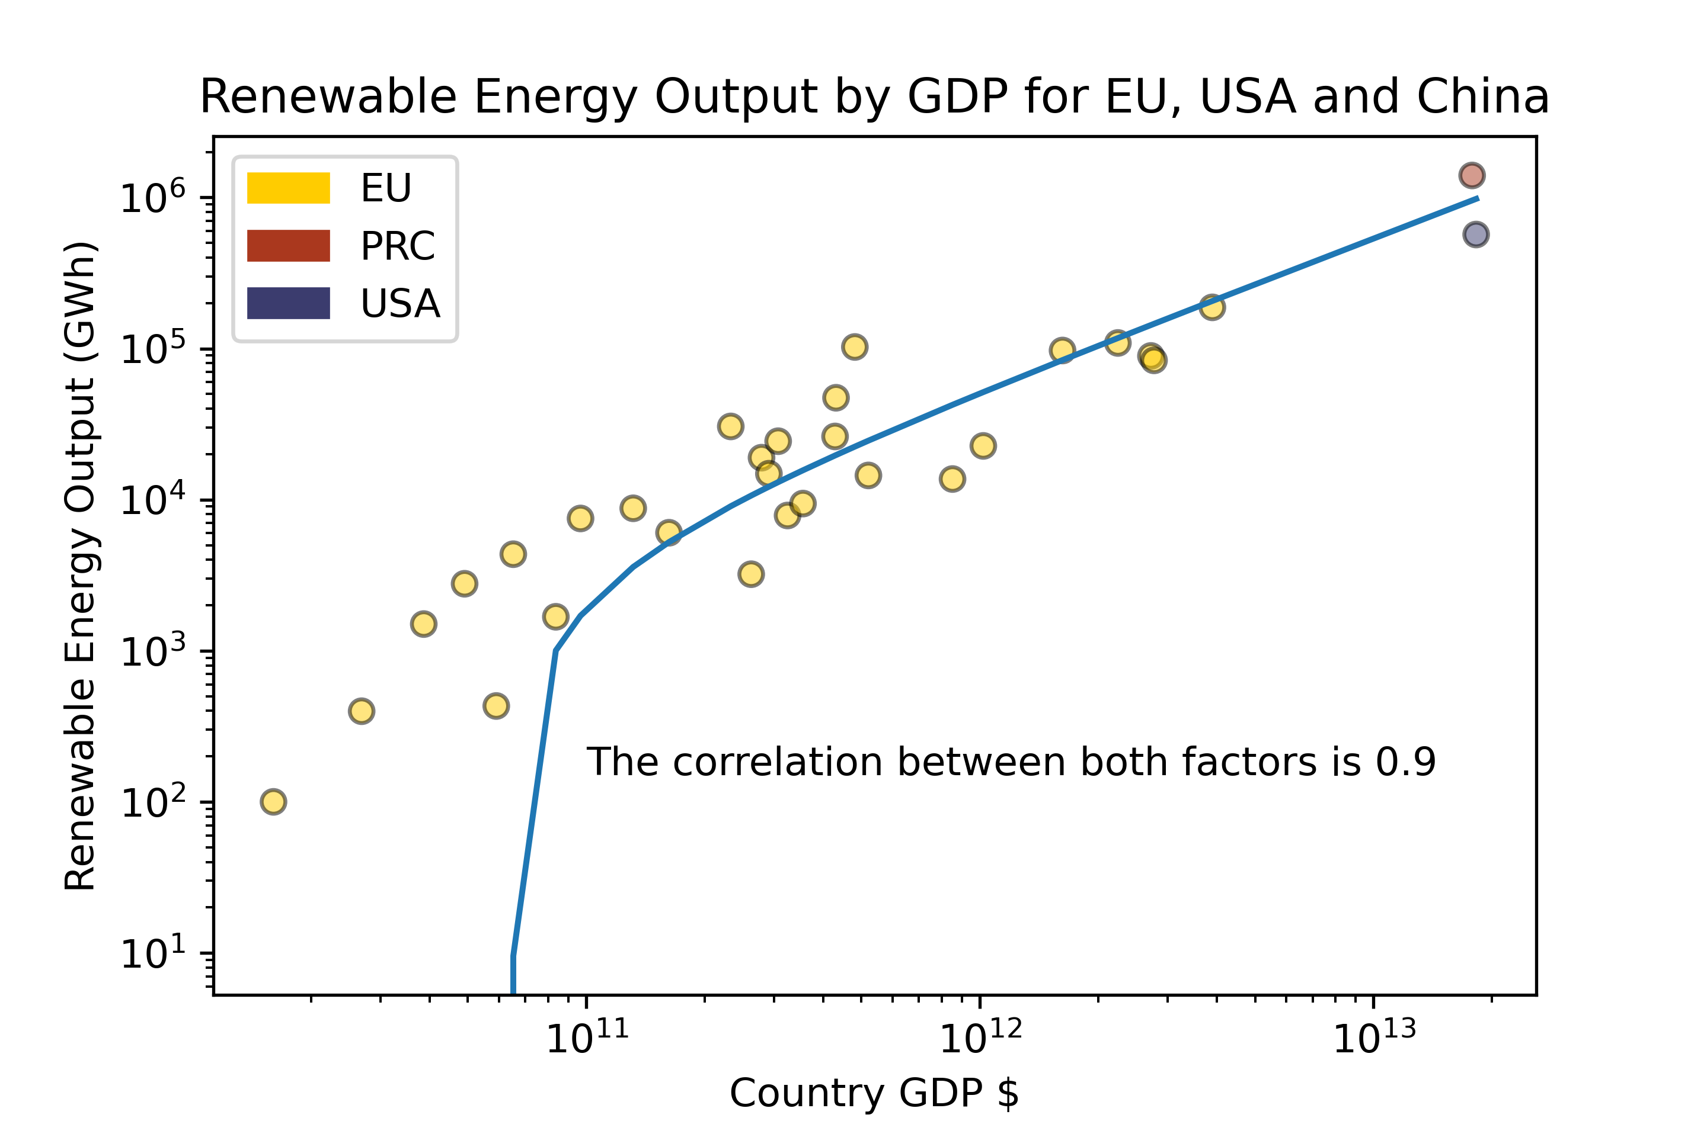
03
ANALYSIS
Energy Consumption
EU, USA and China Renewable Energy Consumption 2015
Bubble Size Depicts Country Total Energy Consumption
*2015 was last year data was publicly available
https://www.iea.org/data-and-statistics?country=WORLD&fuel=Energy%20supply&indicator=Total%20energy%20supply%20(TES)%20by%20source

Slide 17
04
CONCLUSION
Emissions
Investment
Energy Consumption
Between UN member countries, there is a wide disparity between each economic classification and RE consumption
EU, USA and China have all increased RE consumption, but over percentage of total consumption % has not matched.
RE consumption correlates with country GDP, but not RE consumption %. Appears a threshold exists.

Slide 18
04
CONCLUSION
Flaws in Analysis
Limited ability to collect and confirm investment data via multiple sources.
GHG emission data was taken from the IEA as reported by each country. There is potential that either the numbers reported were falsified or that each country used a non-uniform definition in classifying emissions.
Developed countries have a greater incentive to reduce emissions as they have already modernized their infrastructure, economy, etc while developing nations see the requirement to slow down GHG emission as a request to slow down their growth.
Countries do not all have the same natural resources to draw upon so some will be more able to utilize renewable energy compared to others.

Slide 19
04
CONCLUSION Questions
Questions?

Slide 20
04
CONCLUSION Data Sources
https://www.iea.org/data-and-statistics?country=WORLD&fuel=Energy%20supply&indicator=Total%20energy%20supply%20(TES)%20by%20source
https://www.irena.org/Statistics/View-Data-by-Topic/Finance-and-Investment/Renewable-Energy-Finance-Flows
https://www.iea.org/subscribe-to-data-services/energy-technology-rdd
https://www.iea.org/subscribe-to-data-services/co2-emissions-statistics
http://data.imf.org/GDP

Slide 21
04
CONCLUSION Data Sources
IEA. Energy supply. -- https://www.iea.org/data-and-statistics?country=WORLD&fuel=Energy%20supply&indicator=Total%20energy%20supply%20(TES)%20by%20source
IRENA. Finance flows for renewable investment. -- https://www.irena.org/Statistics/View-Data-by-Topic/Finance-and-Investment/Renewable-Energy-Finance-Flows
IEA -- https://www.iea.org/subscribe-to-data-services/energy-technology-rdd
IEA. CO2 Emissions -- https://www.iea.org/subscribe-to-data-services/co2-emissions-statistics
IMF. GDP statistics. -- http://data.imf.org/GDP
World Bank. Energy use data. -- https://databank.worldbank.org/reports.aspx?source=sustainable-energy-for-all

Slide 22
04
CONCLUSION References
Paris Agreement [referring to United Nations (2015), Paris Agreement],United Nations, New York, https://treaties.un.org/doc/Treaties/2016/02/20160215%2006-03%20PM/Ch_XXVII-7-d.pdf.
IRENA (2019), Transforming the Energy System -- and Holding the Line on Rising Global Temperatures, International Renewable Energy Agency (IRENA), Abu Dhabi.
IPCC (2018), Global Warming of 1.5°C. An IPCC Special Report on the impacts of global warming of 1.5°C above pre-industrial levels and related global greenhouse gas emission pathways, in the context of strengthening the global response to the threat of climate change, sustainable development, and efforts to eradicate poverty [Masson- Delmotte, V., P. Zhai, H.-O. Pörtner, D. Roberts, J. Skea, P.R. Shukla, A. Pirani, W. Moufouma-Okia, C. Péan, R. Pidcock, S. Connors, J.B.R. Matthews, Y. Chen, X. Zhou, M.I. Gomis, E. Lonnoy, T. Maycock, M. Tignor, and T. Waterfield (eds.)]. Intergovernmental Panel on Climate Change (IPCC), Geneva, and associated press materials.
IRENA (2019d), Global energy transformation: The REmap transition pathway (Background report to 2019 edition), IRENA, Abu Dhabi.

